Slide 1
Human-level Control Through Deep Reinforcement Learning
Volodymyr Mnih, Koray Kavukcuoglu, David Silver, Andrei A. Rusu, etc.
Project Group: Qingyuan Feng, Jian Jin, Saad Mahboob, Rui Wang

Slide 2
Acknowledgements
This presentation is partially adopted from the presentations by:
Dong-Kyoung Kye, available at: vi.snu.ac.kr/xe
Jiang Guo, available at: http://ir.hit.edu.cn/~jguo/docs/notes/dqn-atari.pdf

Slide 3
Outline
Motivation & Reinforcement Learning
Model Description
Q-Learning
Q-network
Training Q-network
Innovations of the model
Project outline

Slide 4
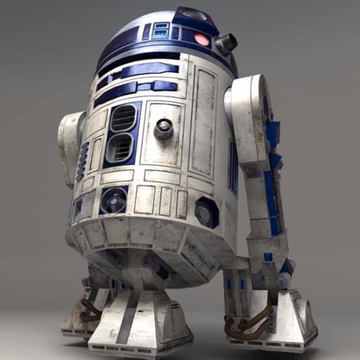
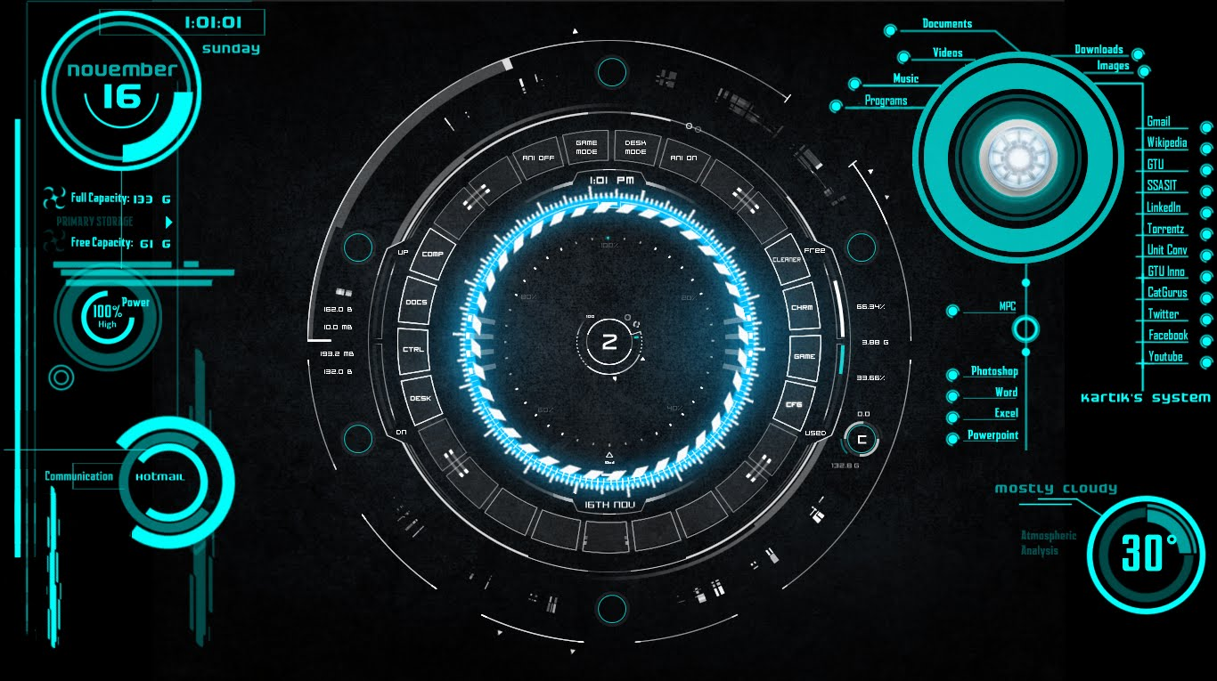
Motivation
Previously the game-playing agents are highly specific to the game
Goal: creating an AI agent capable of playing a wide range of games, one step closer to Jarvis or R2D2
https://www.youtube.com/watch?v=cqXbjyWrdSo
https://twitter.com/r2d2__starwars

Slide 5
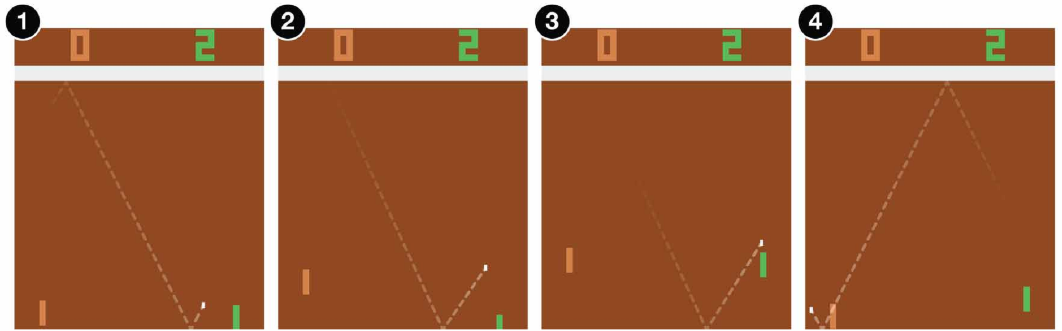
Reinforcement Learning
Want to teach the agent to play games
Supervised learning: let expert players play for 100,000 times
Reinforcement learning is the choice

Slide 6
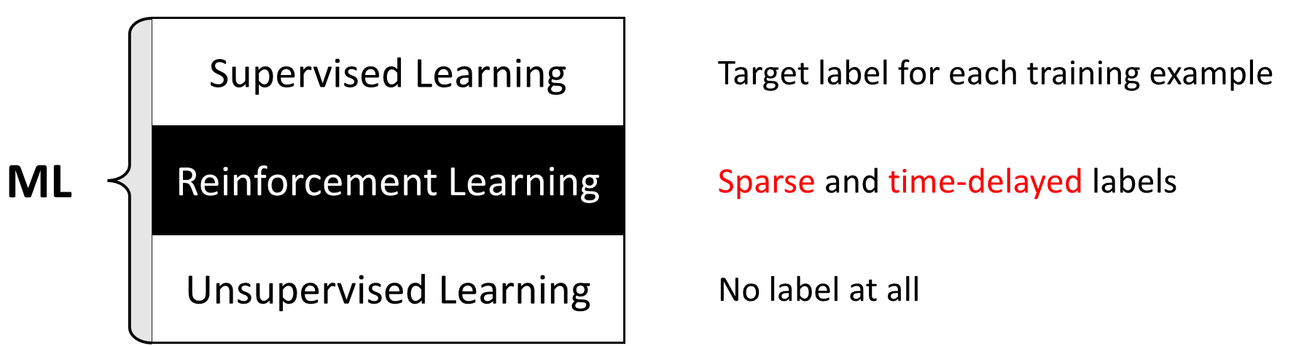
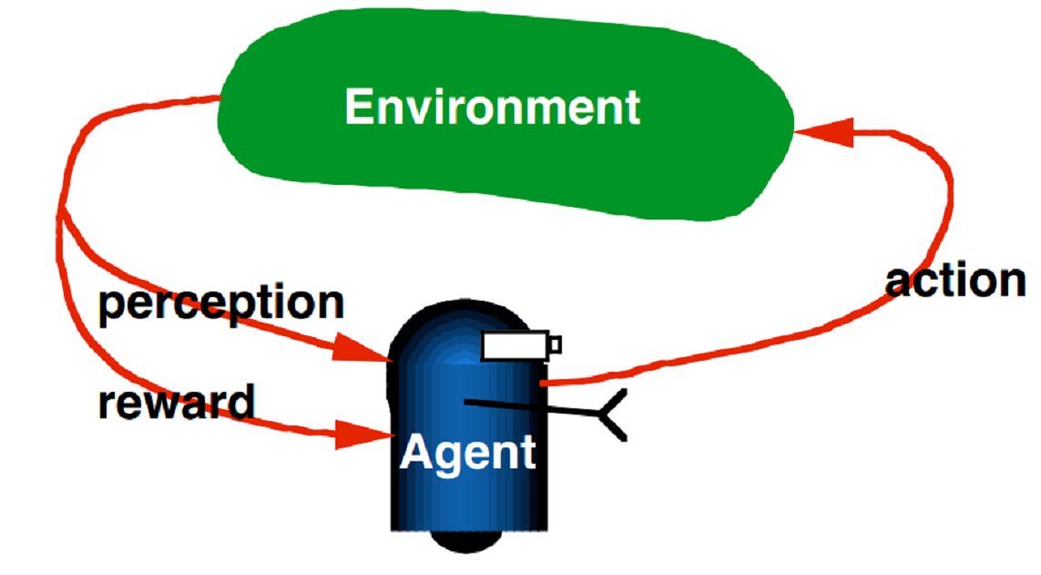
Reinforcement Learning
Categories of ML:
RL mechanism

Slide 7
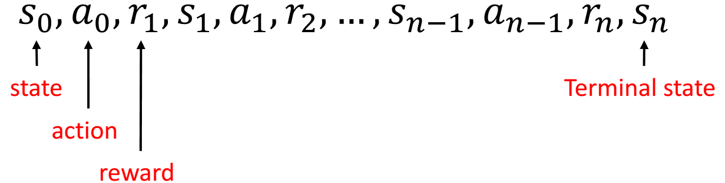
Reinforcement Learning
Markov Decision Process:

Slide 8
Model Description

Slide 9
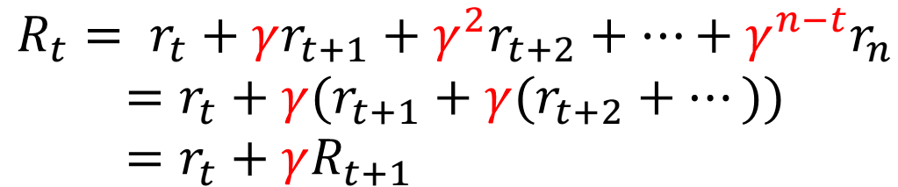
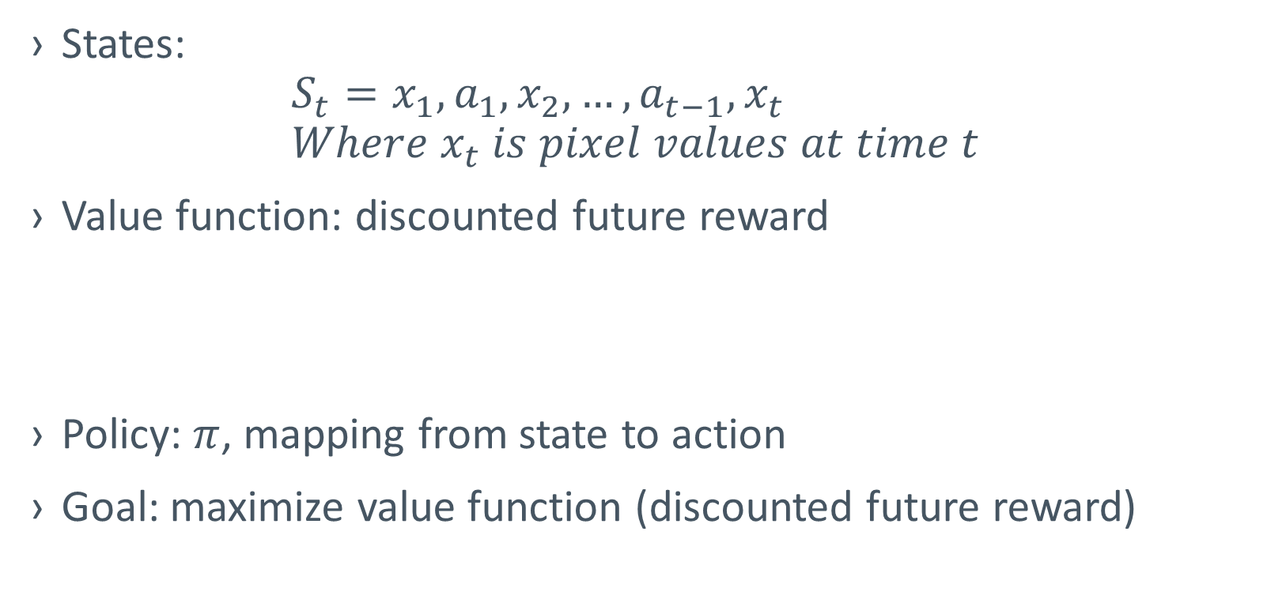
Model components
States: $S_{t}=x_{1},a_{1},x_{2},…,a_{t−1},x_{t}$ $Where x_{t} is pixel values at time t$
Value function: discounted future reward
Policy: $π$, mapping from state to action
Goal: maximize value function (discounted future reward)

Slide 10
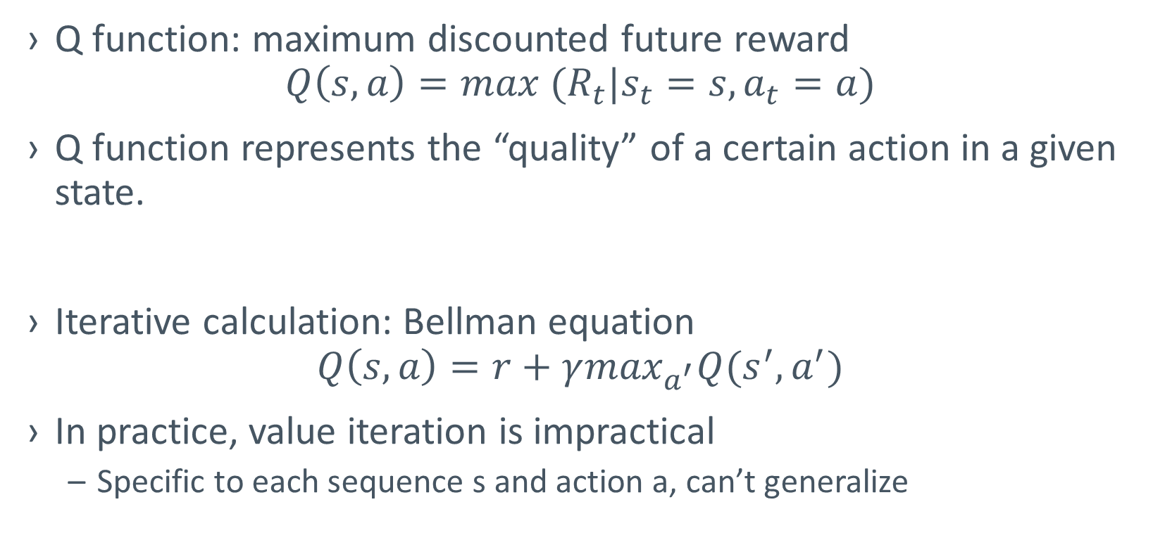
Q-Learning
Q function: maximum discounted future reward $Q\left(s,a\right)=max{ (R}_{t}|s_{t}=s,a_{t}=a)$
Q function represents the “quality” of a certain action in a given state.
Iterative calculation: Bellman equation $Q\left(s,a\right)=r+γ\max_{a^{′}}Q(s^{′},a^{′})$
In practice, value iteration is impractical
Specific to each sequence s and action a, can’t generalize

Slide 11
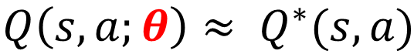
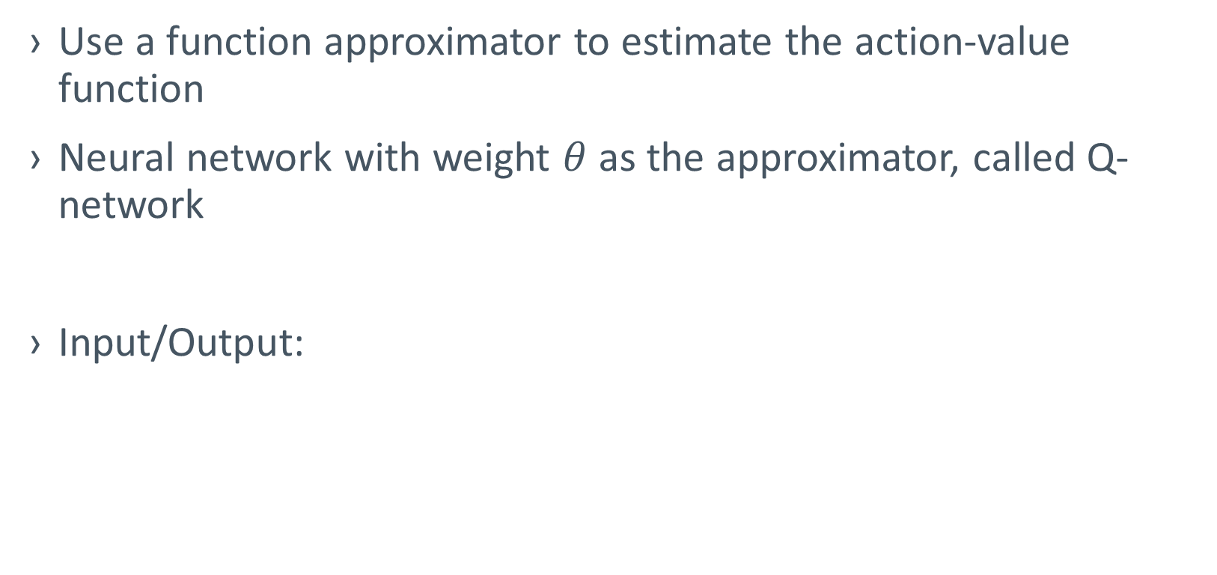
Q-network
Use a function approximator to estimate the action-value function
Neural network with weight $θ$ as the approximator, called Q-network
Input/Output:
Q value of Action 1
Network
Q value of Action 2
State
Q value of Action 3

Slide 12
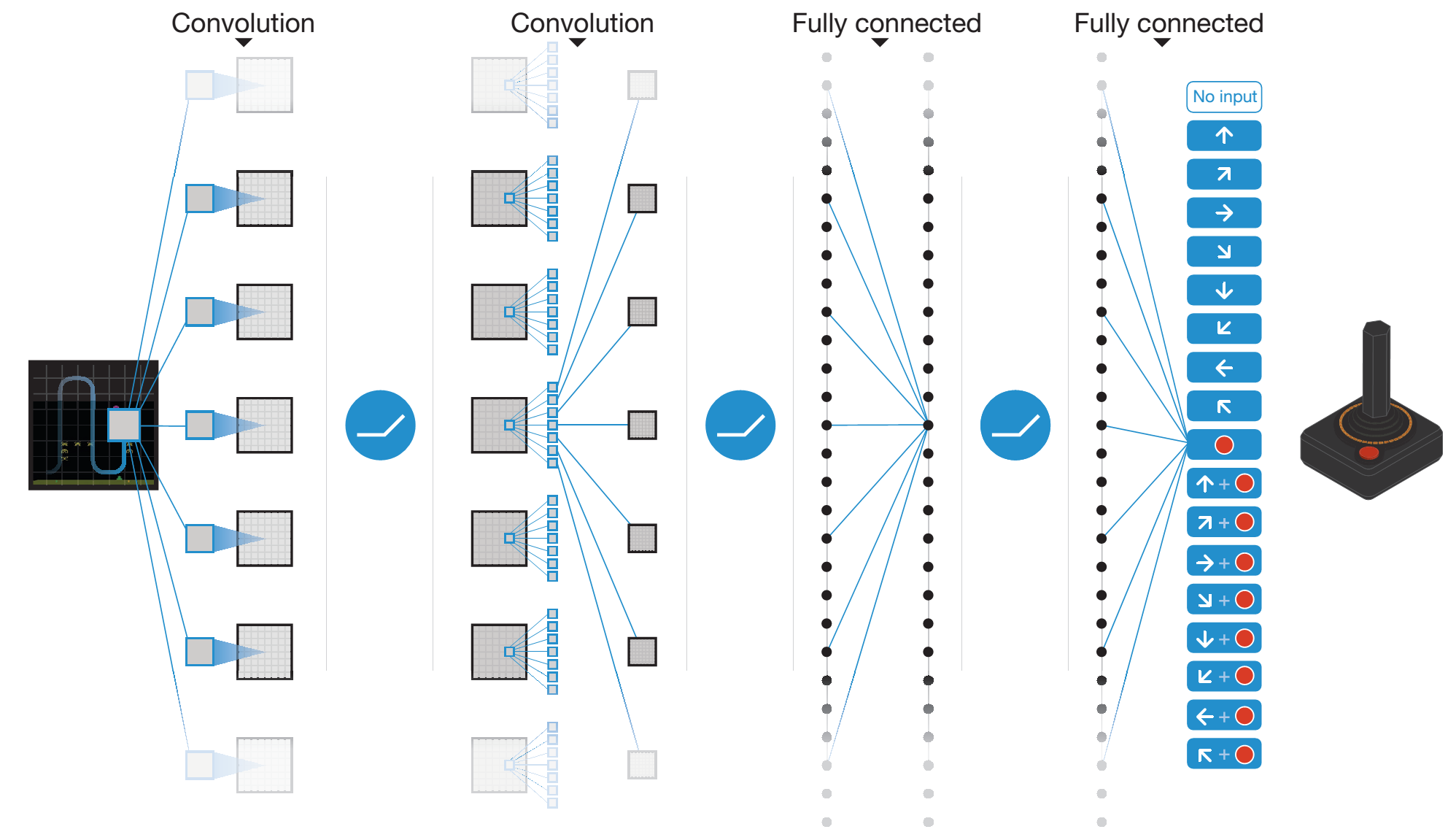
Deep Q-Network

Slide 13
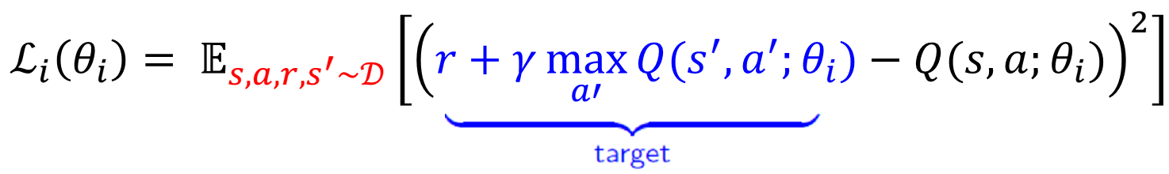
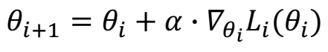
Training Q-Network
Loss function: mean squared error (MSE)
Derivatives w.r.t. the weights:
Using mini-batch SGD

Slide 14
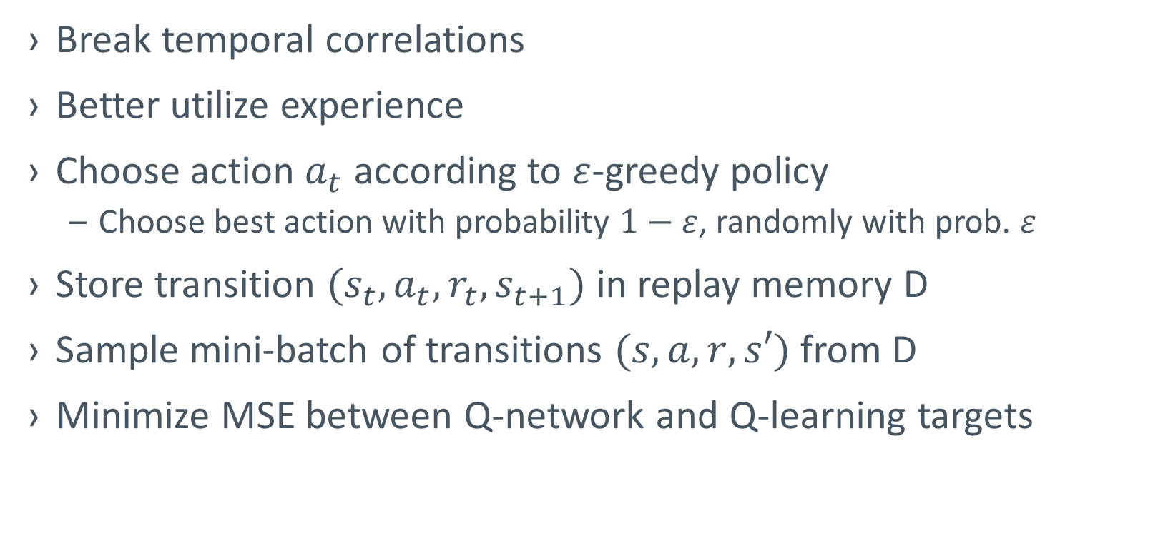
Innovations: Experience Replay
Break temporal correlations
Better utilize experience
Choose action $a_{t}$ according to $ε$-greedy policy
Choose best action with probability $1−ε$, randomly with prob. $ε$
Store transition $(s_{t},a_{t},r_{t},s_{t+1})$ in replay memory D
Sample mini-batch of transitions $(s,a,r,s′)$ from D
Minimize MSE between Q-network and Q-learning targets

Slide 15
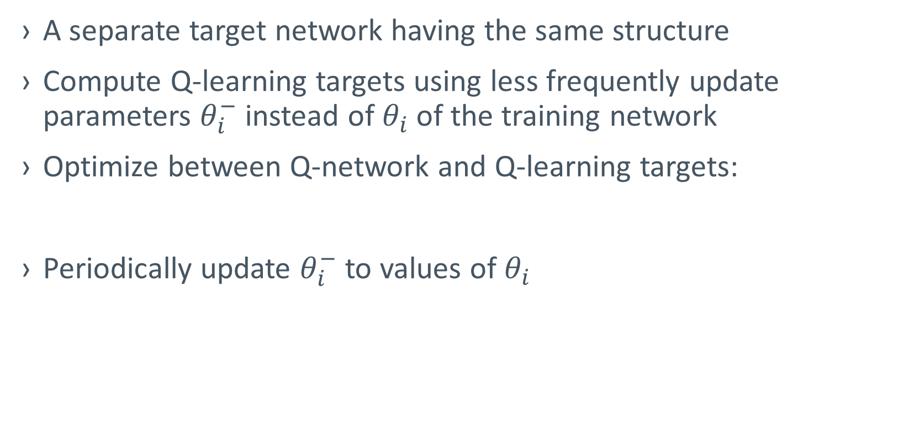
Innovations: separate target network
A separate target network having the same structure
Compute Q-learning targets using less frequently update parameters $θ_{i}^{−}$ instead of $θ_{i}$ of the training network
Optimize between Q-network and Q-learning targets:
Periodically update $θ_{i}^{−}$ to values of $θ_{i}$

Slide 16
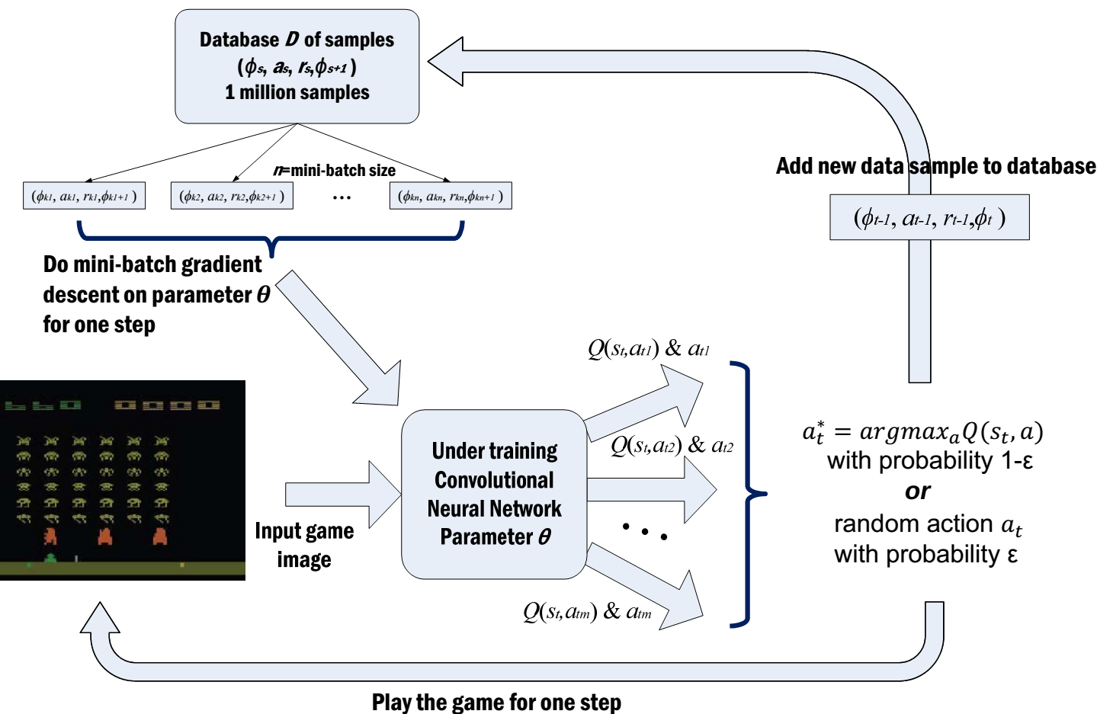
Complete workflow

Slide 17
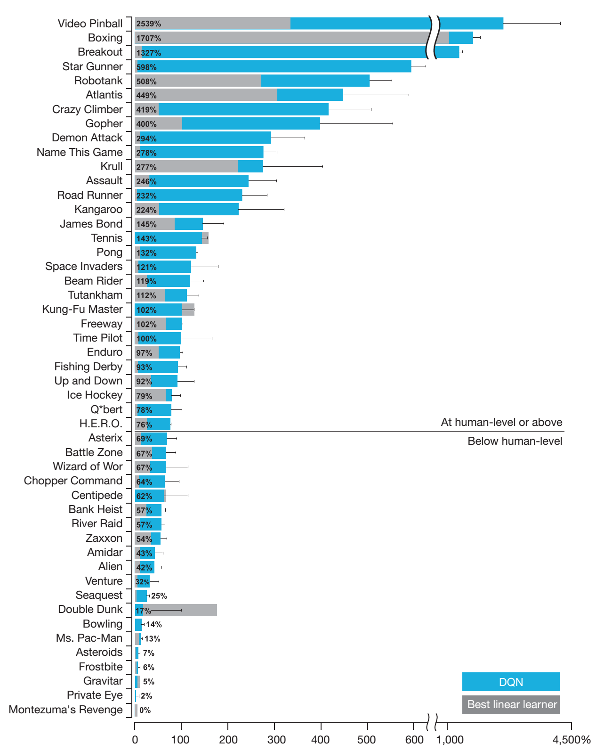
Results

Slide 18
Deep Continuous Control for Self Driving Car Simulation

Slide 19
Self Driving Car

Slide 20
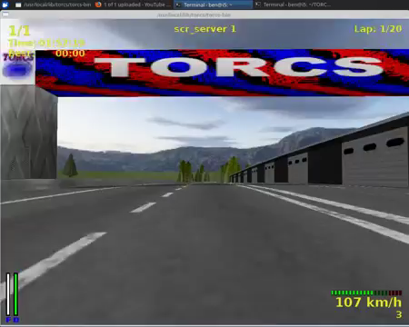
How to Handle Continuous Control?

Slide 21
How to Handle Continuous Control?
Name | Range (units) | Description
ob.angle | [-π,+π] | Angle between the car direction and the direction of the track axis
ob.track | (0, 200)(meters) | Vector of 19 range finder sensors: each sensor returns the distance between the track edge and the car within a range of 200 meters
ob.trackPos | (-∞,+∞) | Distance between the car and the track axis. The value is normalized w.r.t. to the track width: it is 0 when the car is on the axis, values greater than 1 or -1 means the car is outside of the track.
ob.speedX | (-∞,+∞)(km/h) | Speed of the car along the longitudinal axis of the car (good velocity)
ob.speedY | (-∞,+∞)(km/h) | Speed of the car along the transverse axis of the car
ob.speedZ | (-∞,+∞)(km/h) | Speed of the car along the Z-axis of the car
ob.wheelSpinVel | (0,+∞)(rad/s) | Vector of 4 sensors representing the rotation speed of wheels
ob.rpm | (0,+∞)(rpm) | Number of rotation per minute of the car engine

Slide 22
How to Handle Continuous Control?
The DQN is designed for the discrete output
The Continuous Output is High dimensional

Slide 23
Deep Deterministic Policy Gradient
Critic Network
Correlated Metric
Actor Network

Slide 24
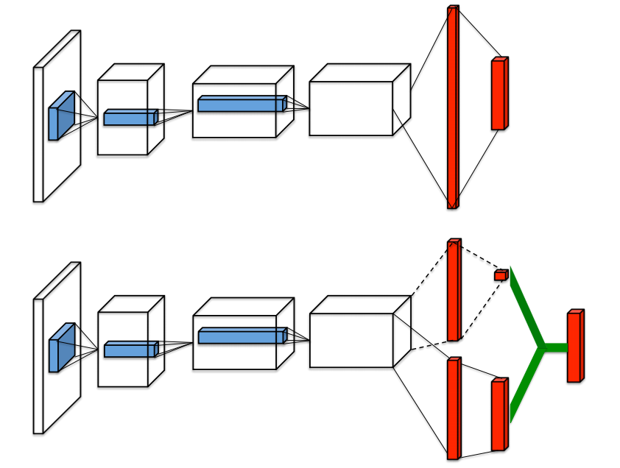
Dueling Network

Slide 25
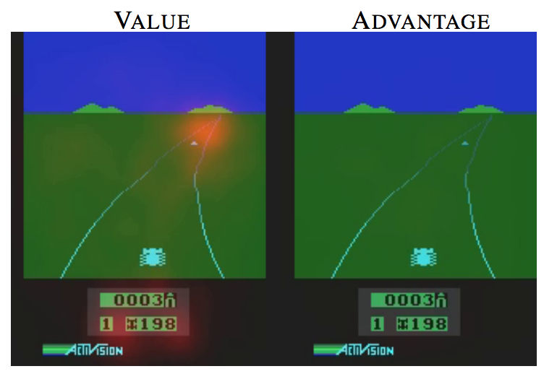
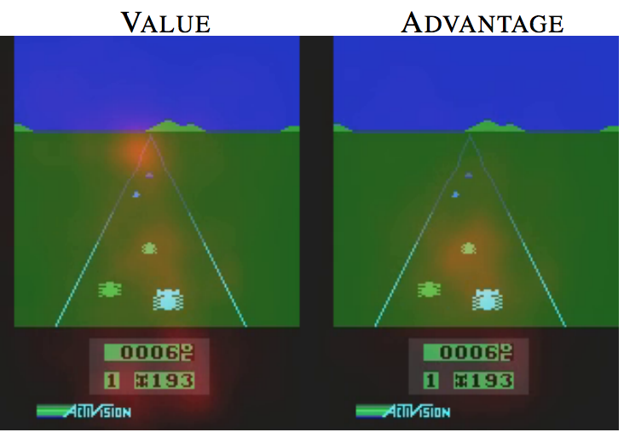
Attention Example

Slide 26
How to Choose Attention
The Attention would reduce the dimensionality of processing
Add Mixture Layer for Convolutional Features
Preprocess the frames, to get differential information

Slide 27
DeeP refinforcement Learning
Thank you!

